Slide 1

CUSTOMER PERSONALITY ANALYSIS-DETERMINE THE SUITABLE PRODUCTS THAT IS HIGHLY POPULAR AMONG VARIOUS TARGET CUSTOMER SEGMENTS.
GROUP- 3
Aishwarya Ajay mate
Miss. Poonam Patil
Miss. Kavana E
Miss. Shinjitha VP
Mr. Sohil Khursheed
Miss. Ayshwarya O
MENTOR
Group Members:

Slide 2
OBJECTIVE:
Project Problem:
Need to perform clustering to summarize customer segments.
Customer Personality Analysis is a detailed analysis of a company’s ideal customers. It helps a business to better understand its customers and makes it easier for them to modify products according to the specific needs, behaviors and concerns of different types of customers.
Customer personality analysis helps a business to modify its product based on its target customers from different types of customer segments. For example, instead of spending money to market a new product to every customer in the company’s database, a company can analyze which customer segment is most likely to buy the product and then market the product only on that particular segment.

Slide 3
Project Architecture / Project Flow
EDA:
Description of Data
Correlation, covariance, VIF
Univariate, Bivariate analysis
Data Collection
Missing Value Treatment
Data Visualization:
Plots
Heat Map
Bar charts, Line Charts
Feature Engineering:
Feature Scaling
Normalization
Standardization
Feature Selection
Model Evaluation:
Evaluation Metrics
Confusion Matrix
Model Creation
Algorithm Selection
Model Validation:
K Fold
Model Deployment

Slide 4
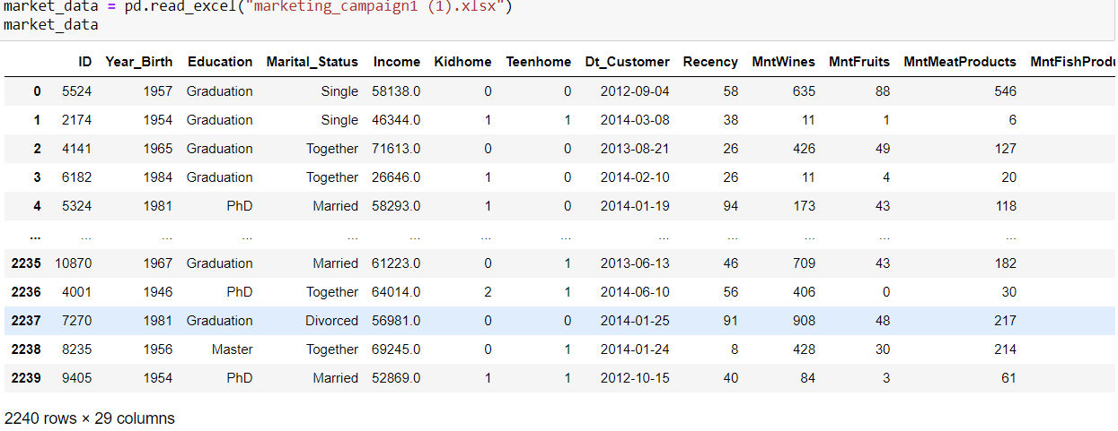
DATA IMPORT
There are 2240 rows and 29 columns altogether in the given datatset

Slide 5
DATA SET DETAILS
-Data has total distribution of 2 years from 2012-2014
-There are 2240 rows and 29 columns in the dataset.
- Columns consists of ID, Year_Birth, Education, Marital_Status, Income, Kidhome, Teenhome, Dt_Customer, Recency, MntWines, MntFruits, MntMeatProducts, MntFishProducts, MntSweetProductsMntGoldProds,NumDealsPurchasesNumWebPurchasesNumCatalogPurchases,NumStorePurchasesNumWebVisitsMonth
AcceptedCmp3,AcceptedCmp4, AcceptedCmp5, AcceptedCmp1, AcceptedCmp2,
Complain, Z_CostContact, Z_Revenue, Response.
_
Datatypes present: datetime64[ns](1), float64(1), int64(24), object(2)

Slide 6
Conclusion:
There are 14 missing values in Income feature.
Dt_Customer indicates the date on that date customer joined the database is not parsed as DateTime.
There are some categorical features in our data frame(feature's data type like-> dtype: object).
So we will need to encode them into numeric forms later.

Slide 7
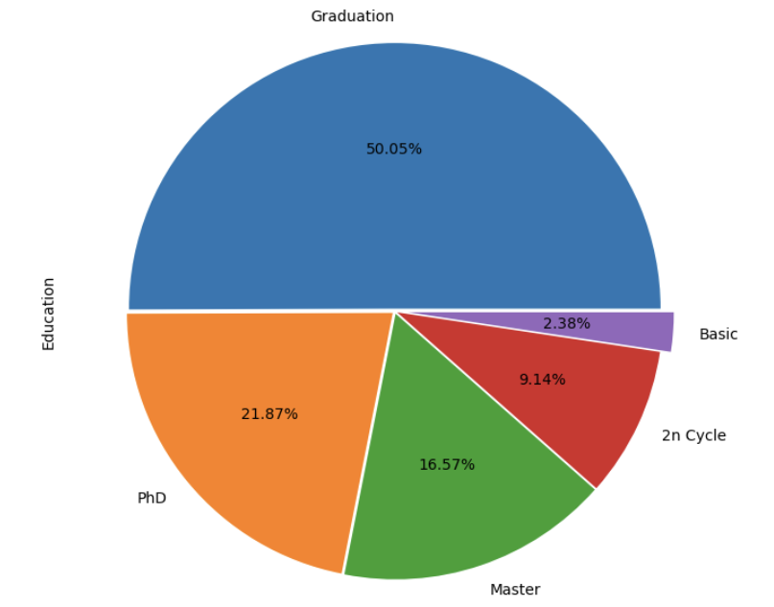
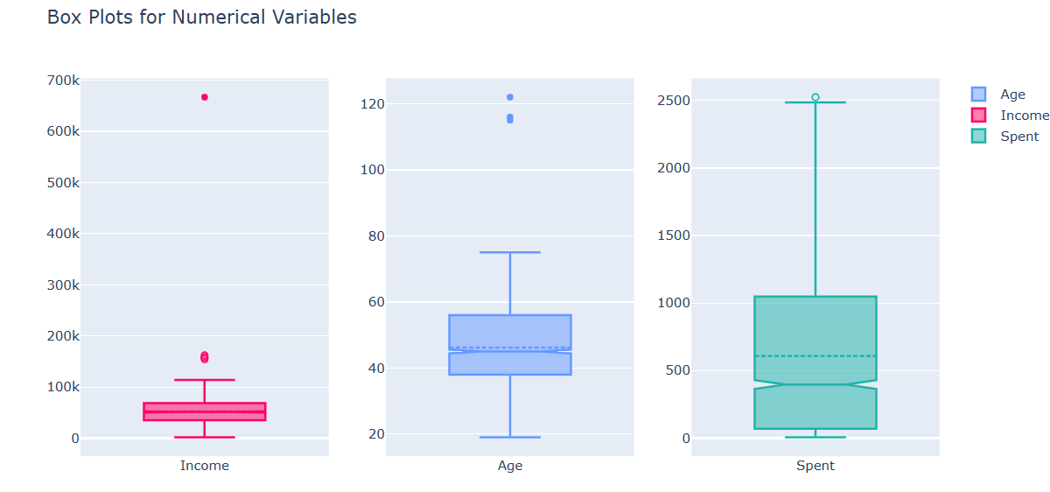
Plot Diagrams

Slide 8
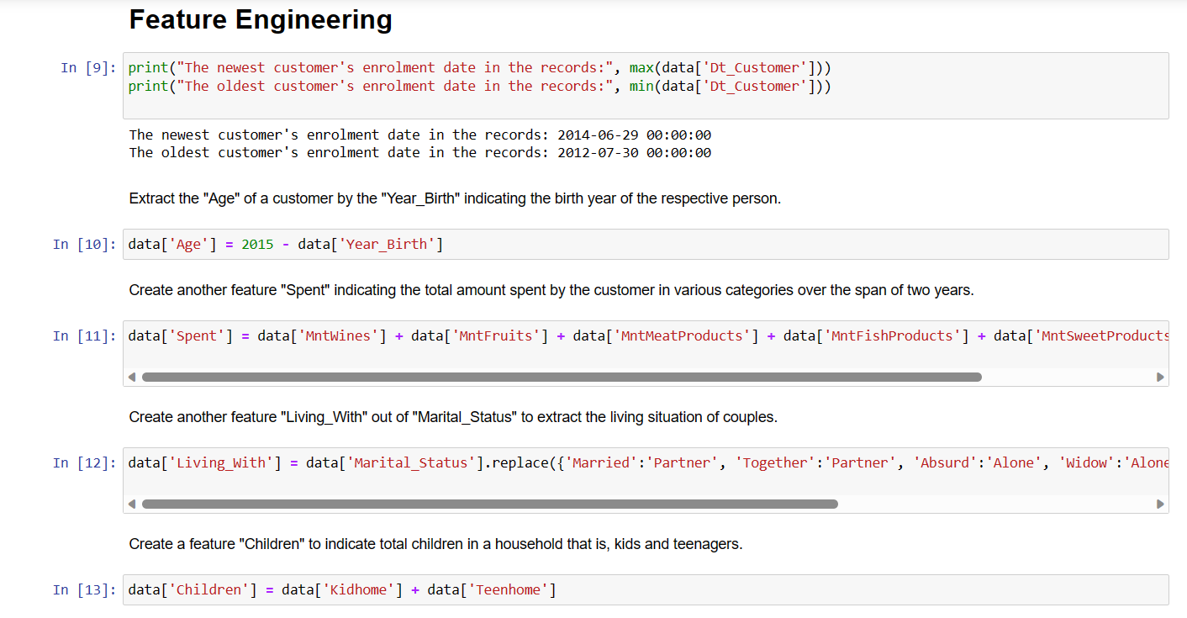

Slide 9
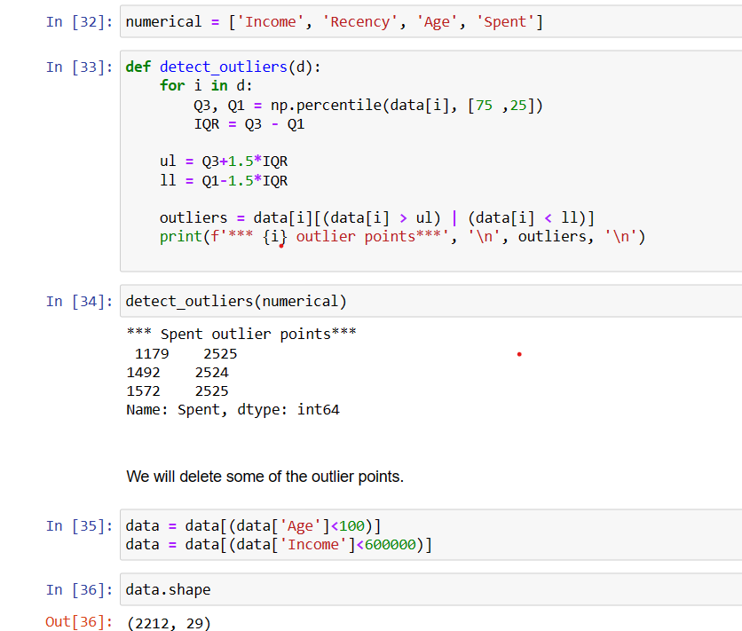
We detect the outliers using 5-Number summary and drop those outliers as they are less in number

Slide 10
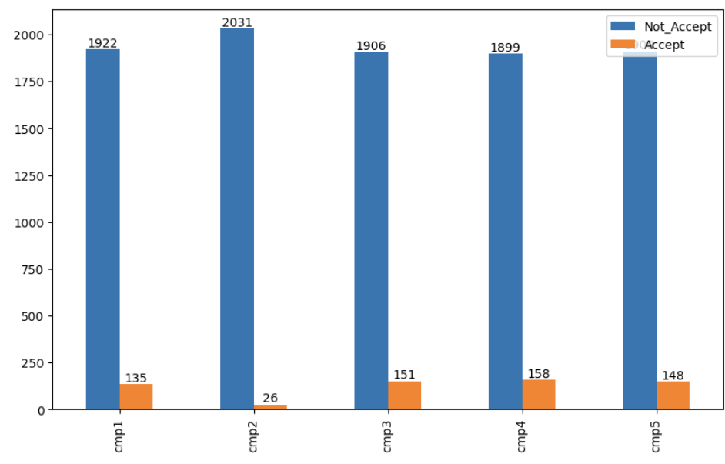
​
Barplot of the total distribution of the customer having accepted and nonaccepted the offer campaign

Slide 11
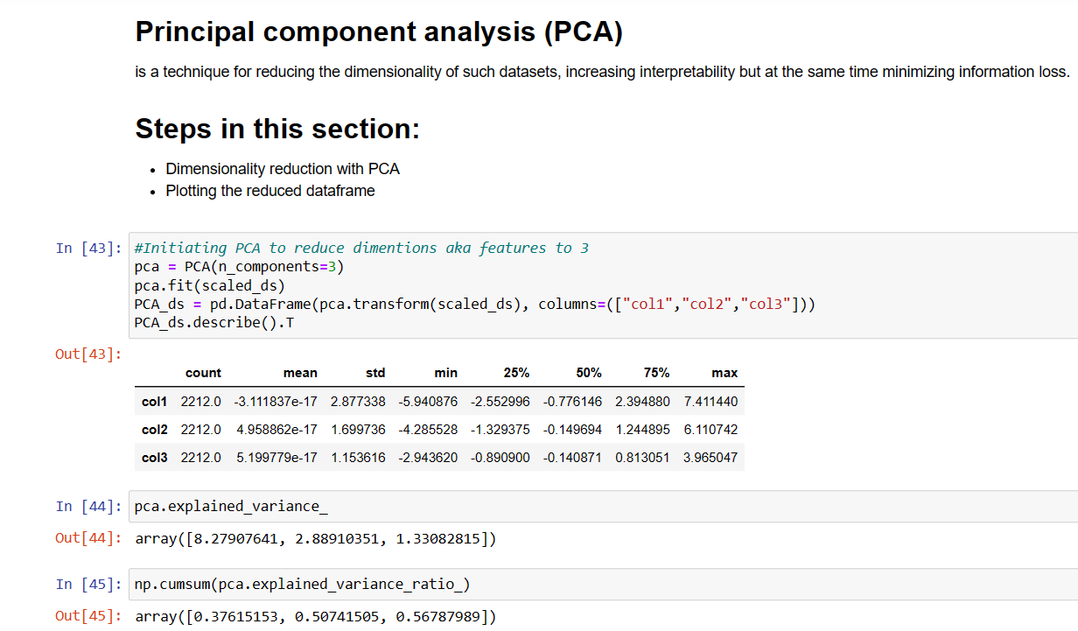

Slide 12
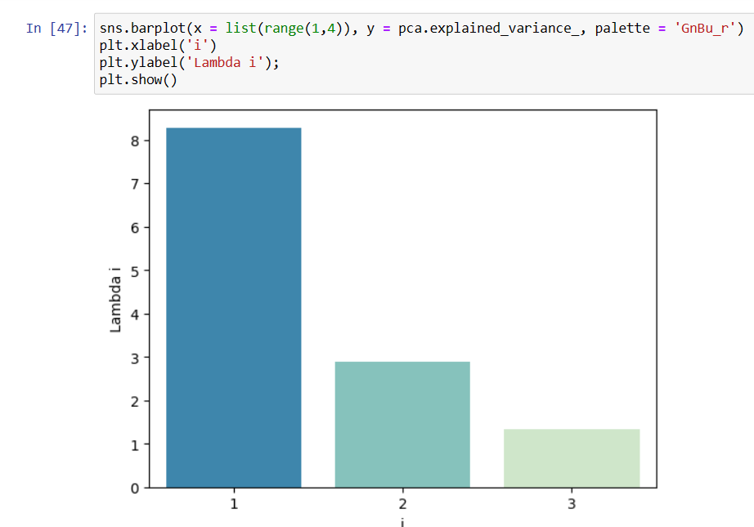
Bar Plot of the PCA data

Slide 13
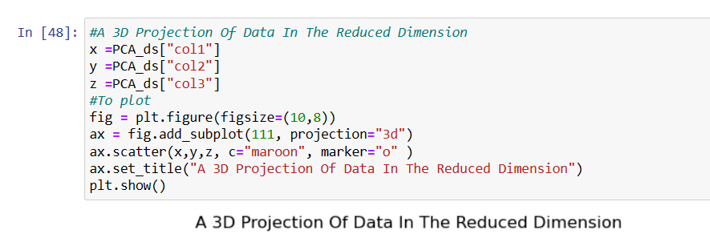
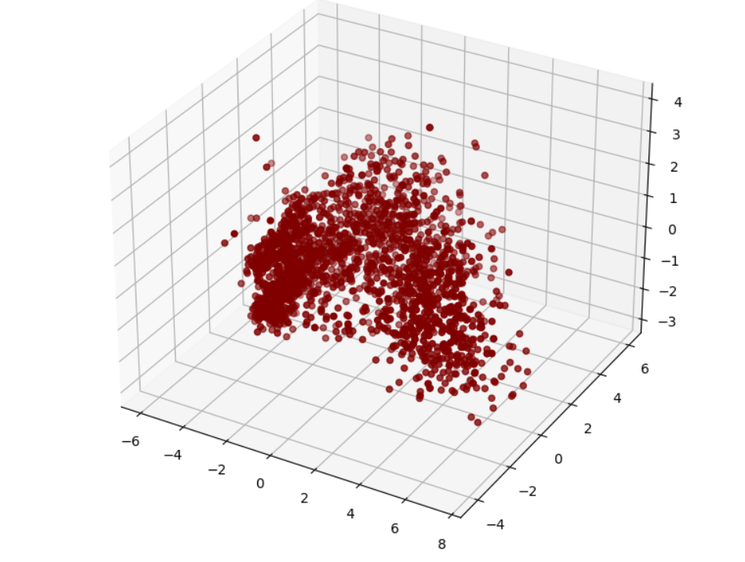

Slide 14
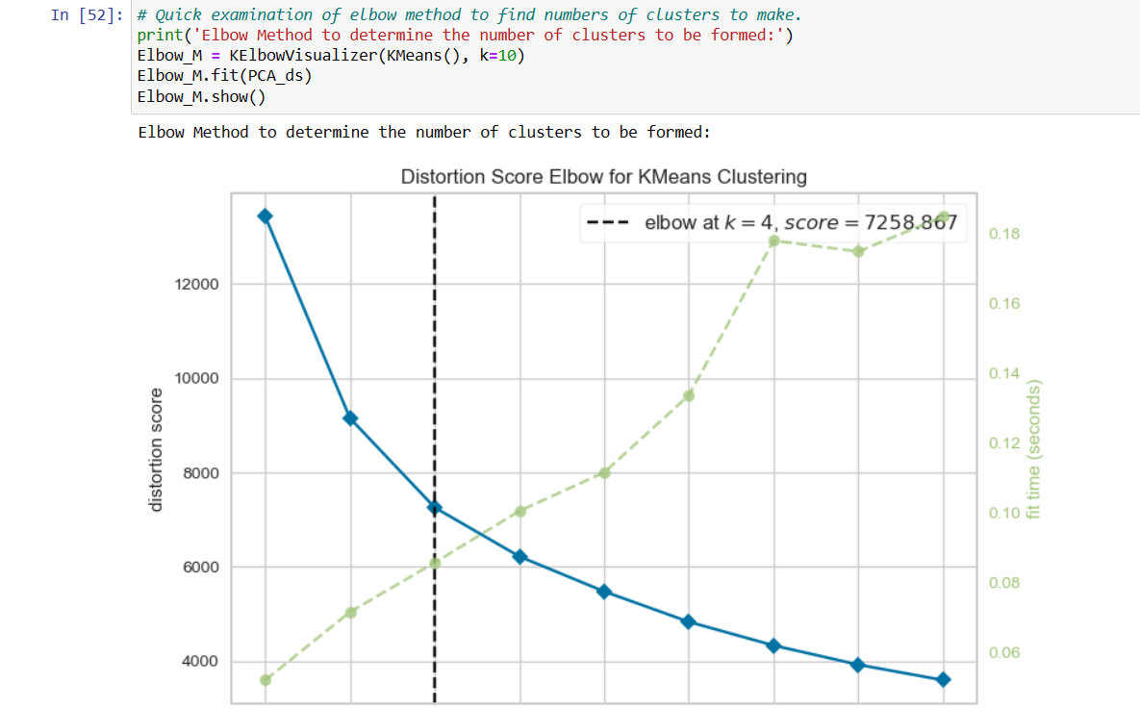
Result indicates that 4 will be an optimal number of clusters for this data. Now fitting the Clustering Model to get the final clusters.

Slide 15
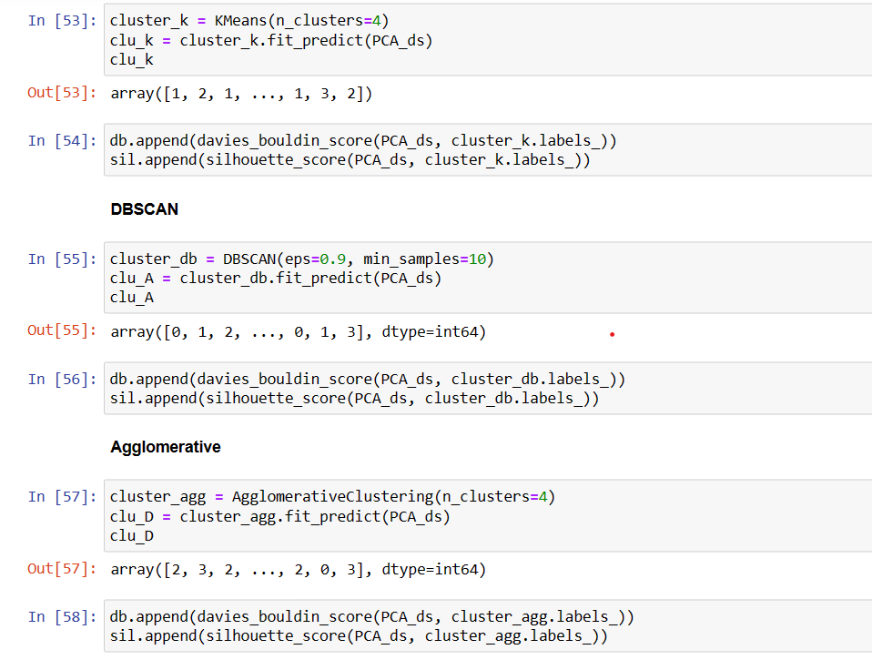
Clustering Algorithms:

Slide 16
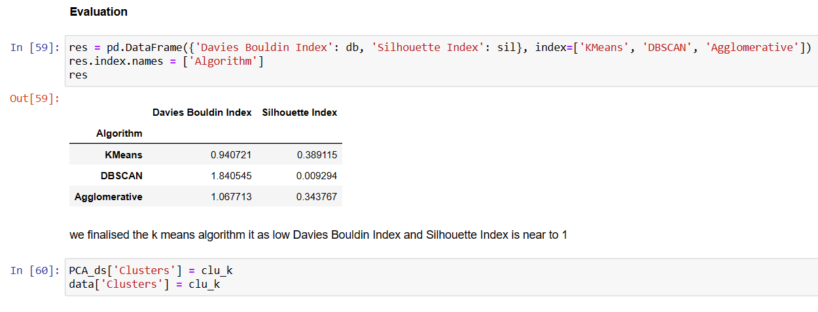
Evaluation of clustering algorithms using Silhouette score and Davis Bouldin Index

Slide 17
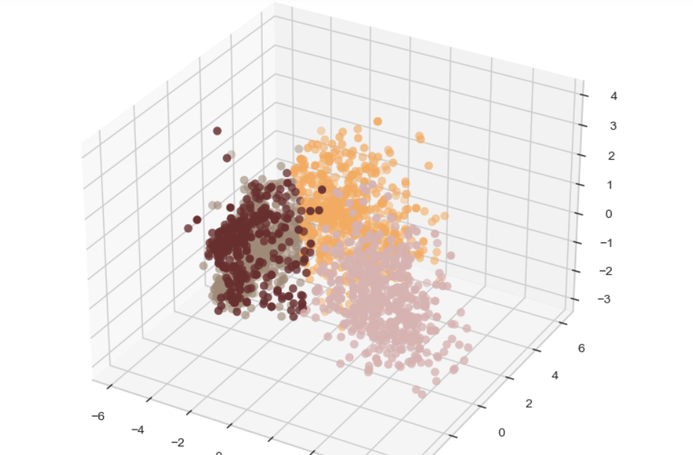
3-D Distribution of Clusters

Slide 18
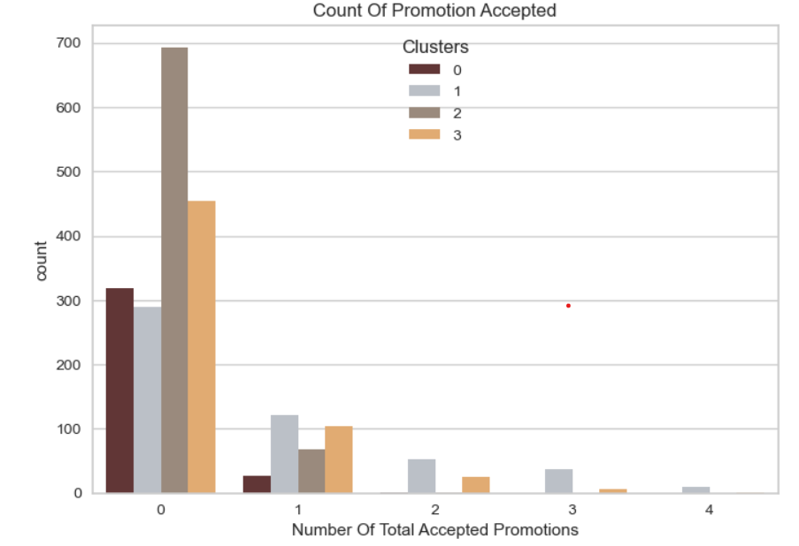
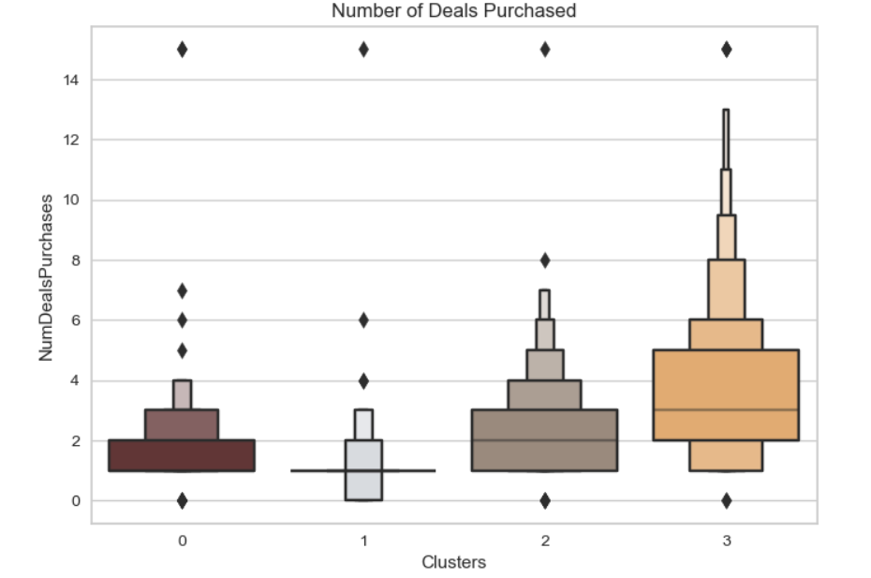
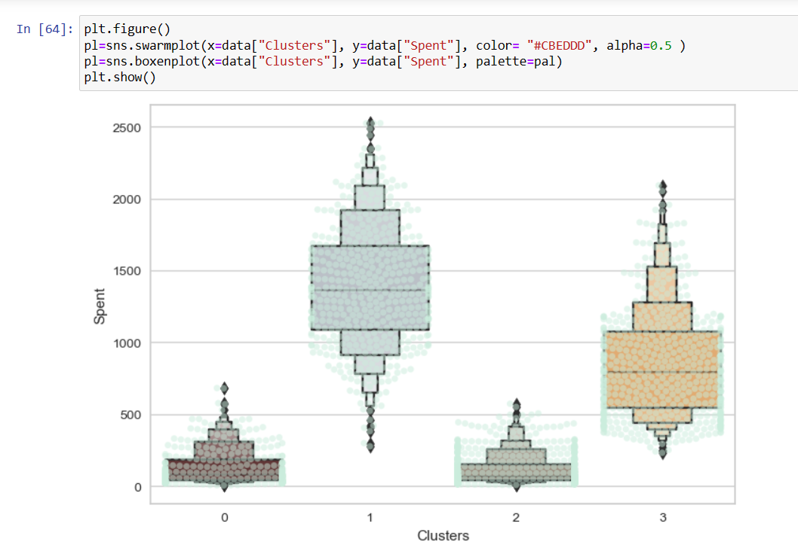
From the above plot, it can be clearly seen that cluster 1 is our biggest set of customers closely followed by cluster 3. We can explore what each cluster is spending on for the targeted marketing strategies.

Slide 19
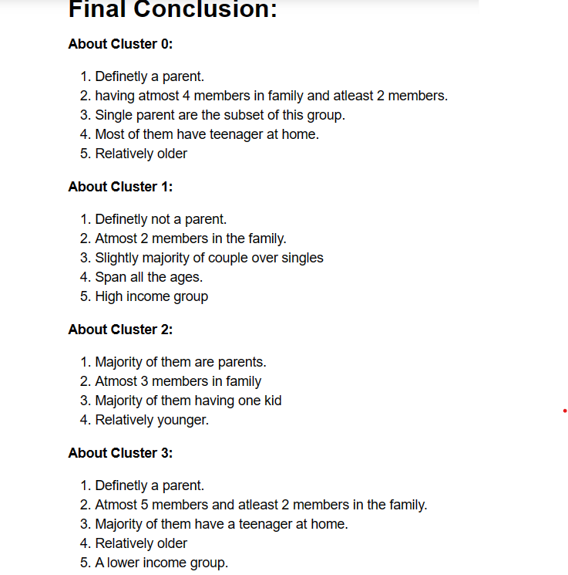

Slide 20
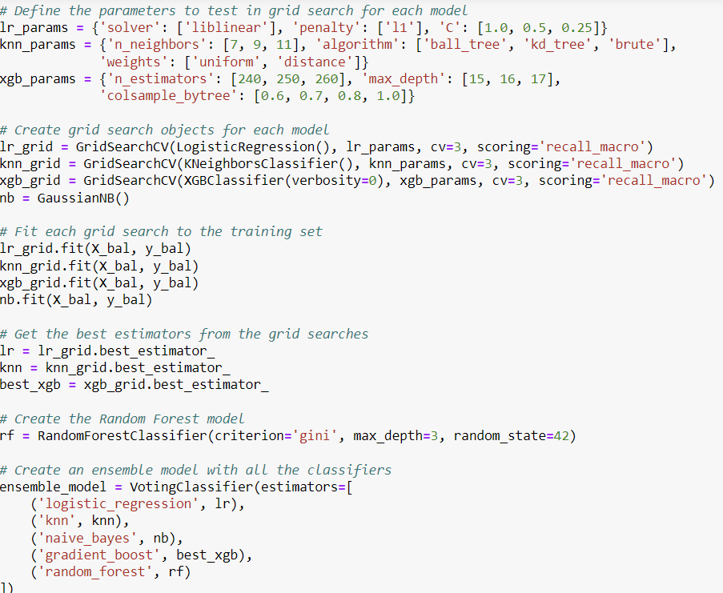
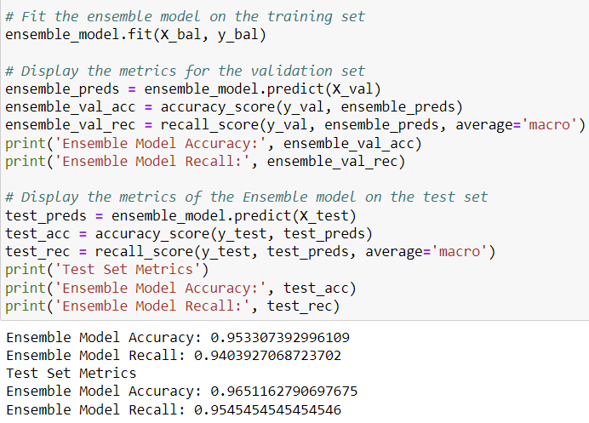

Slide 21
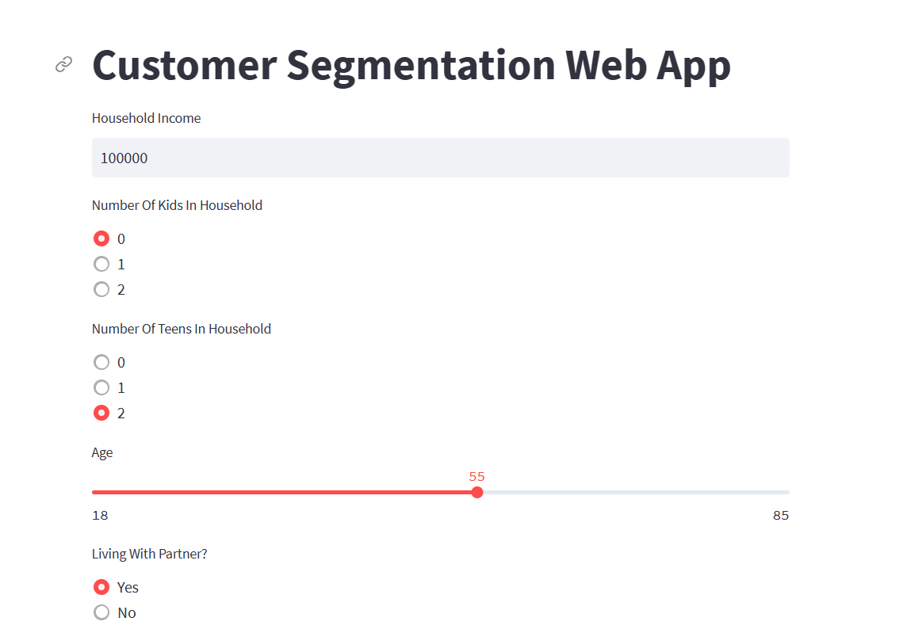
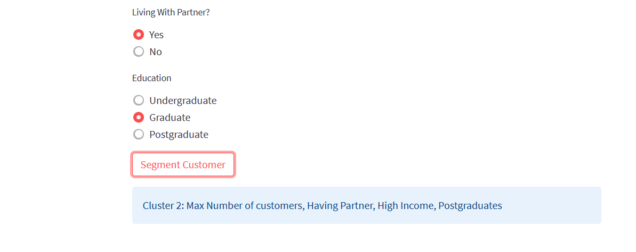
DEPLOYMENT OF CLUSTERING MODEL BY USING STREAMLIT
Deployment windows pic

Slide 22
CHALLENGES FACED DURING THE PROJECT
Hard to achieve a enough adequate silhouette scores using unsupervised clustering algorithms .
Facing the problem during data preprocessing
Faced challenge during the visualization part to draw conclusions
In PCA to select n_components
During Model Building which algorithm has to select
Faced problem to draw conclusions from resulted clusters.

Slide 23
Thank you

